Slide 1
PHYSICAL VS DIGITAL:
COMIC BOOKS IN A DIGITAL AGE
Cosmic Comics
March 2025

Slide 2

Question:
Since we live in a digital age and the cost of products and goods continue to rise, will the comic book industry thrive in a 100% digital format?

Slide 3
Answer:
The comic book industry has seen significant changes in both physical and digital sales over the years. While digital formats are growing, physical comic books still dominate the market. Here's a timeline of the sales trends for both formats:
2018: Digital comic book sales in North America were estimated at $100 million, while physical comic book stores generated about $510 million, with booksellers adding another $465 million.
2019: Overall comic book sales rose approximately 4%, with digital sales continuing to grow but still significantly lower than physical sales.
2020: The COVID-19 pandemic led to a surge in online activity, including digital comic book reading. However, physical comic books remained the preferred format for many readers.
2024: The global comic book market was valued at $16.83 billion, with projections to reach $17.69 billion in 2025 and $26.75 billion by 2032. The market includes both physical and digital formats, with physical comics still holding a significant share.
Despite the growth in digital sales, the emotional attachment to physical comic books and the experience of visiting comic book stores continue to drive physical sales. It seems unlikely that the industry will convert to a 100% digital format in the near future, as both formats have their unique appeal and advantages.

Slide 4
How can a smaller, independent company thrive in this digital age?
Utilize Digital Platforms – Use a digital platform such as Comixology to get your work out to the public. With enough revenue generated from digital sales, then this will provide capital to invest in physical releases.
Crowdfunding – You can start campaigns with crowdfunding, such as, Kickstarter to have fans help build enough revenue for a comic series that they may be interested in. This will help cover the cost of printing, distributing, and getting the physical version of your comic in the hands of the fans.
Comic Cons – Appearing at comic cons is a huge way to engage with your audience. Not only can you sell your comic there in person, but you can talk to your fans and get any sort of feedback that’s face-to-face.
Social Media – In order to survive in a digital age, you must have a digital footprint. The best way to get there is have a social media platform. Most companies use just about every platform to reach each customer, i.e. Facebook, Instagram, X, Tiktok, etc.

Slide 5
Digital Pros | Digital Cons
Saving on printing and distribution | Neglecting the physical comic fans
Issues arrive on schedule | Losing the heartbeat of the comic industry
Your sales are distributed by a single source i.e., Comixology | Less sales when you can obtain sales for both physical and digital
Physical Pros | Physical Cons
Getting comics into the hands of collectors and fans | Rising costs in printing and distribution
Adding a physical channel for your revenue | Distribution scheduling issues causing delays
Able to run a business model that larger companies use i.e., Marvel, DC, Image | Shipping delays can occur if stores don’t get the comics by Wednesday (New issues are released every Wednesday)

Slide 6
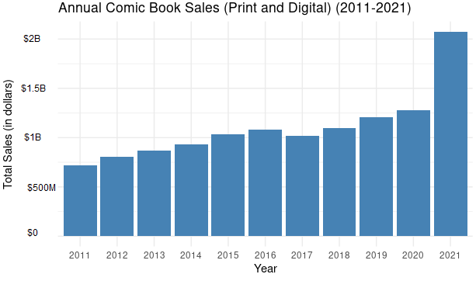
Sources – Comichron and IVC2

Slide 7
How can we generate enough revenue for publication?
Step 1 – Kickstarter/Crowdfunding
Step 2 – Social Media presence to announce and generate interest in crowdfunding
Step 3 – Once Kickstarter ends, then go into production with the number of necessary physical copies
Step 4 – After a successful Kickstarter, then meet with local comic shops to sell issues and do a signing at those locations

Slide 8
Since we live in a digital age and the cost of products and goods continue to rise, will the comic book industry thrive in a 100% digital format?
A majority of the comic industry publications come from physical copies. Even though there is revenue for a digital format, the industry is thriving enough to generate plenty of revenue for both physical and digital. Even with rising costs, the physical side of the industry is still in demand.

